Slide 1
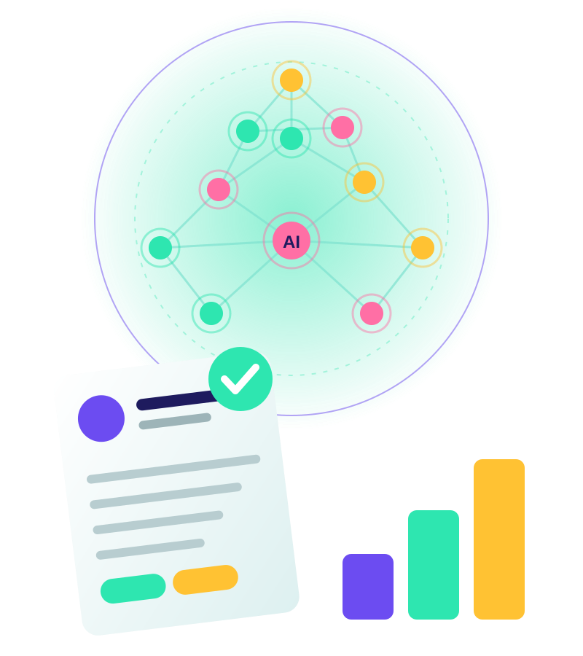
Intelligent Resume & Career Optimization Agent
Team Members
Tulasi
Aswitha
Gayathri
Venkata Lakshmi
Sravani

Slide 2
Problem and solution
The problem
Our solution
Generic resumes that miss the target role
Unclear skill gaps and no roadmap
No feedback on progress toward job-readiness
Analyzes profile or uploaded resume with AI
Compares it with the target role
Builds a roadmap and updates it as you learn

Slide 3
Getting started: two entry paths
Login / Sign up → Welcome → Choose an option
1
I don't have a resume
2
I have a resume
Enter profile information
Upload resume
Education, skills, projects and interests are collected directly.
AI resume analysis reviews content, strengths and weaknesses.
Both paths converge: Career Goal → Select Target Role

Slide 4
The AI Career Agent
1
2
3
4
Analyze profile
Analyze target role
Compare both
Skill gap analysis
Reads skills, experience and education.
Identifies what the role expects.
Matches profile against role needs.
Pinpoints what is missing.
Output feeds directly into the career plan.

Slide 5

From gaps to a personalized roadmap
1
Personalized roadmap
Career Plan
Long-term path tailored to you
Built from the skill gap analysis, with milestones toward your target role.
2
Weekly tasks
Focused goals for each week
3
Daily tasks
Small actions the user completes

Slide 6
The continuous improvement loop
User completes task
Update progress
AI re-evaluation
1
2
3
Update skill gaps
Update career plan
Optimize resume
4
5
6
Each cycle keeps the plan and the resume aligned with real progress.

Slide 7
Job readiness check
Job readiness
NOT YET
READY
Continue plan
Apply
Track progress

Slide 8
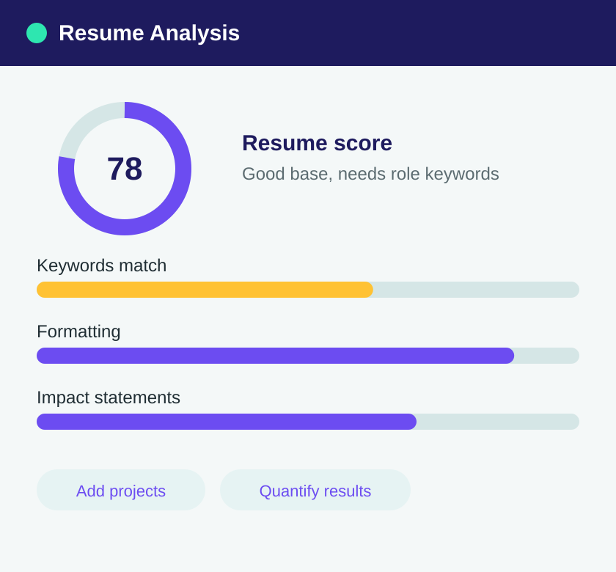
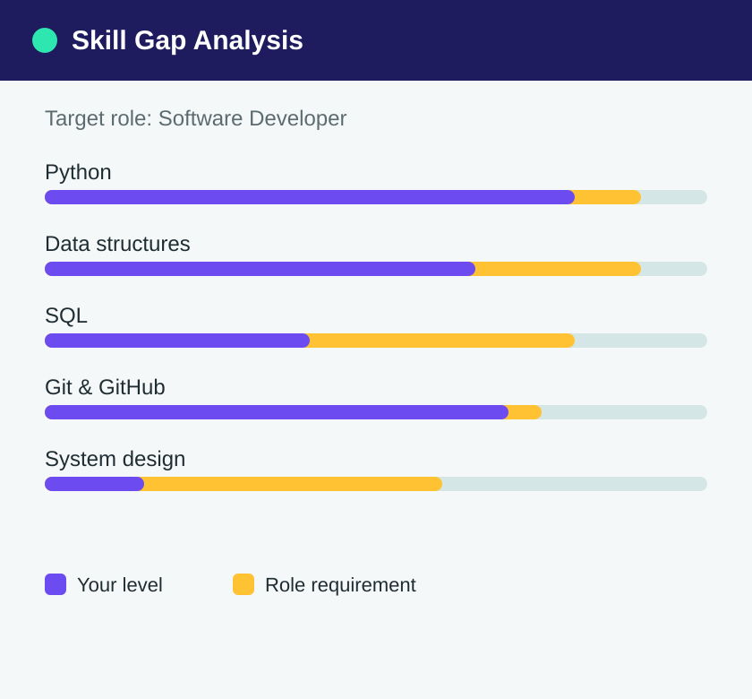
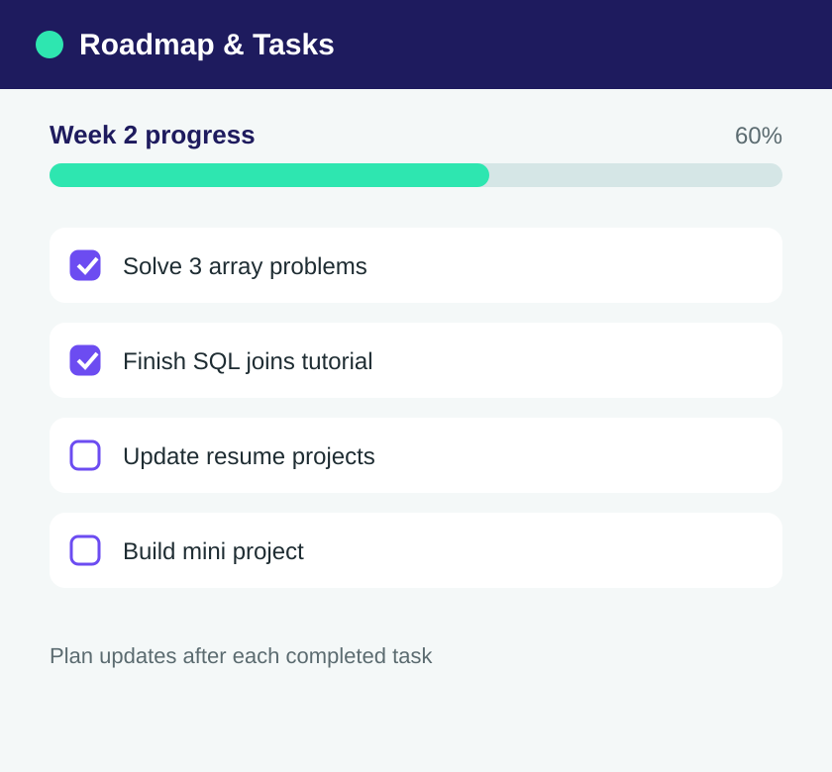
App preview
Resume analysis
Skill gap analysis
Roadmap & daily tasks
Illustrative mockups of the planned screens.

Slide 9
Key benefits
1
2
3
Personalized
Adaptive
Actionable
Plans built around your profile and target role
Re-evaluates skill gaps after every completed task
Daily and weekly tasks, plus an optimized resume

Slide 10
Thank you
Intelligent Resume & Career Optimization Agent

